Slide 1

Data Modelling For PowerCo
Presented by– Vikas G N

Slide 2
Objectives
To predict the probability of customer churn on Powerco
To understand the data and provide insights
To help decide if PowerCo should offer a 20% discount to customers who are likely to churn

Slide 3
About the dataset
We are given 3 training datasets
ml_case_training_data.csv – The training set (with 16096 records) contains information about customers
ml_case_training_hist_data.csv – This training set (with 193002 records) contains pricing data
ml_case_training_output.csv- This training set contains target label churn

Slide 4
Attributes of the dataset
Id
Category of Company activity
Past electricity consumption
Forecast of consumption for next year,
Date of activation of contract
Date of renewal
Past gas consumption
Margin
Price of energy and gas
Churn over the last three months

Slide 5
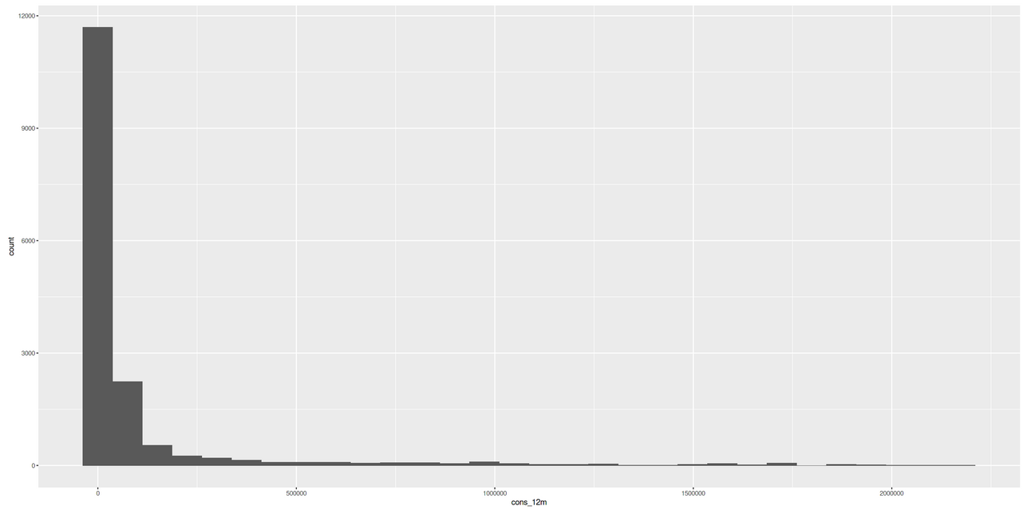
Data cleaning

Slide 6
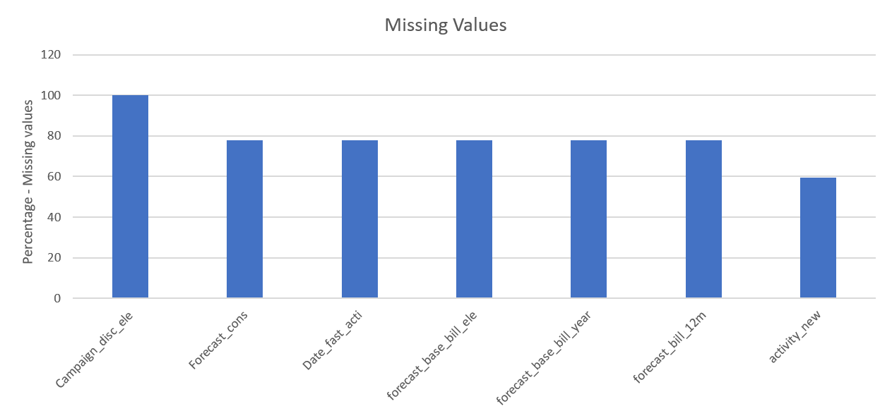
Data cleaning

Slide 7
Churn rate in 3 months

Slide 8
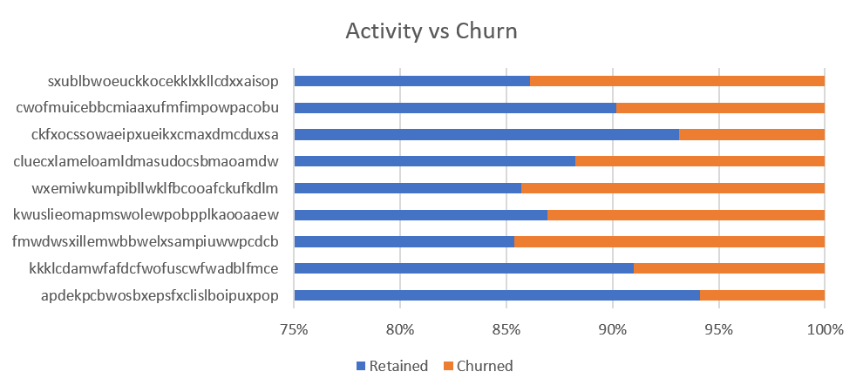
Customer Activity vs churn

Slide 9
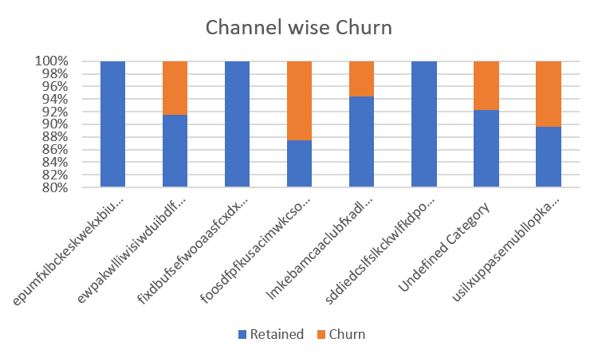
Channel vs churn

Slide 10
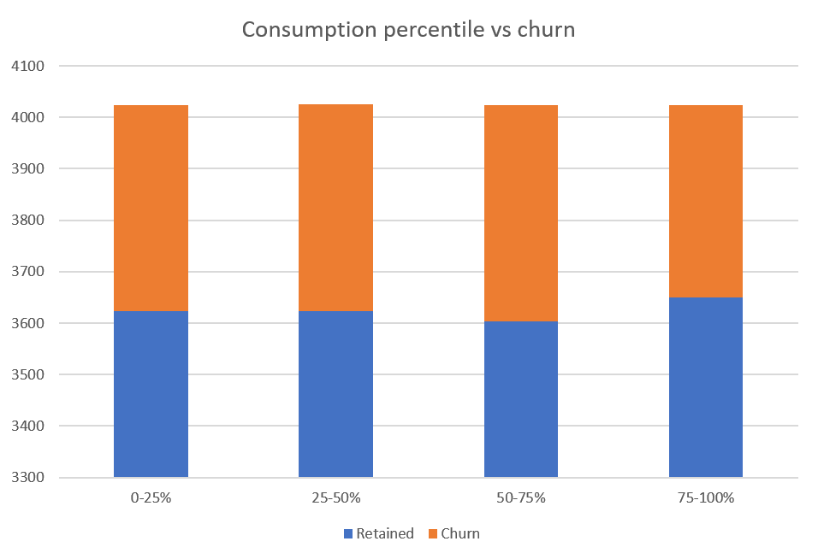
Consumption vs churn

Slide 11
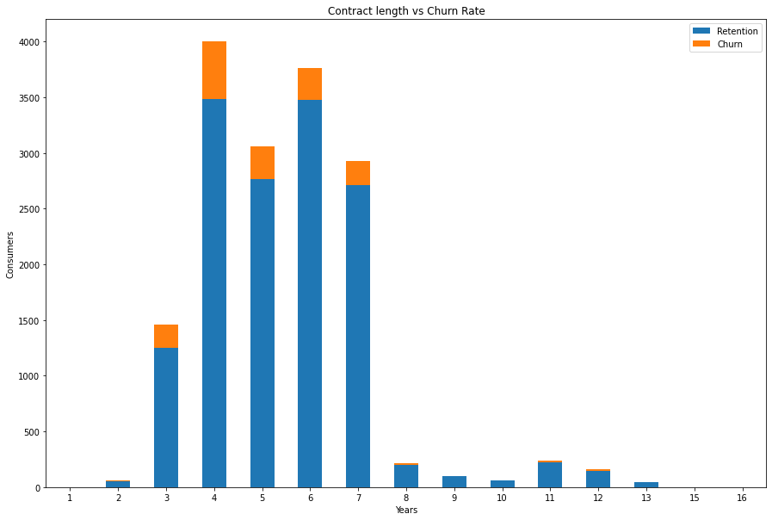
Contract length vs churn

Slide 12
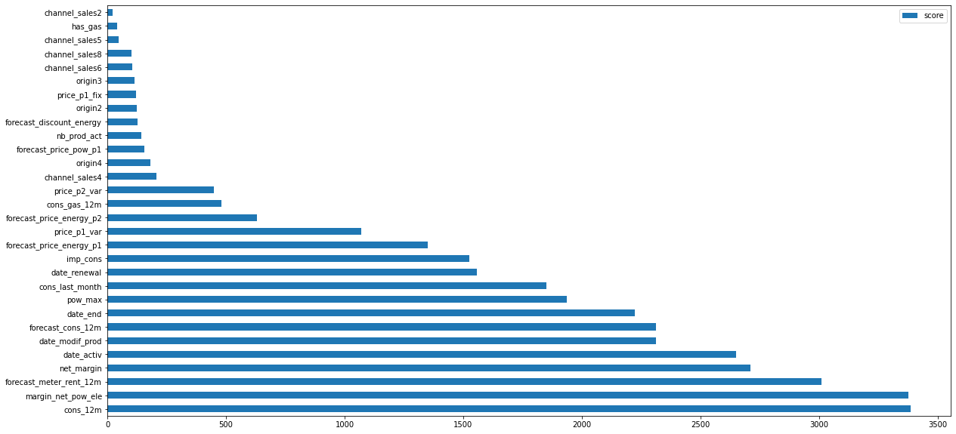
Important Features

Slide 13
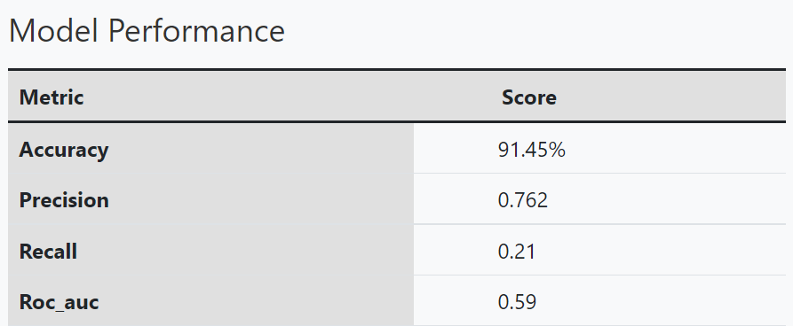
Performance

Slide 14
Thank you

